Slide 1

Project Presentation On “Flight Price Prediction”

Slide 2


Slide 3
Presented By: Ashwini A. Patil
submission
Date:25/07/2022

Slide 4
Acknowledgement:
Primarily I would like to thank God to being able to complete this project with success. Then I would like to express my special thanks of gratitude to my SME,
And I am thankful I am part of flip rob technology of employee, who given me the golden opportunity to do this wonderful project on the given topic which is also help me in doing a lot of research and I came to know about so many new things, I am really thankful to flip robo.
ASWINI A. PATIL
DATE:24/06/2022
Data Science course
Institute: Data trained education
Internship: Flip Robo technology @Bangalore

Slide 5
Overview:
In this particular presentation we will be looking on:
How to analyze the dataset of Flight Price Prediction.
What are the EDA steps in cleaning the dataset.
Overall analysis on the problem.
Model building from cleaned dataset.
Predicting Flight Price for saved best model.

Slide 6

Problem Statement:
Anyone who has booked a flight ticket knows how unexpectedly the prices vary. The cheapest available ticket on a given flight gets more and less expensive over time. This usually happens as an attempt to maximize revenue based on –
1. Time of purchase patterns (making sure last-minute purchases are expensive)
2. Keeping the flight as full as they want it (raising prices on a flight which is filling up in order to reduce sales and hold back inventory for those expensive last-minute expensive purchases)
So, you have to work on a project where you collect data of flight fares with other features and work to make a model to predict fares of flights.

Slide 7
Problem Understanding:
Flight prices are something unpredictable. It’s more than likely that we spent hours on the internet researching flight deals, trying to figure an airfare pricing system that seems completely random every day. Flight price appears to fluctuate without reason and longer flights aren’t always more expensive than shorter ones.
But now the question is how to know proper Flight price, for that I have built a Machine learning model which can predict the Flight price. Using various features like Airline, Source, Destination, Arrival time, Departure time, Stops, Travelling date and the Price for the same travel. So using all these previously known information and analysing the data I have achieved a good model that has 82% accuracy. So let’s understand what all the steps we did to reach this good accuracy.

Slide 8

What is Flight Price Prediction?
Nowadays, the number of people using flights has increased significantly. It is difficult for airlines to maintain prices since prices change dynamically due to different conditions. That’s why we will try to use machine learning to solve this problem. This can help airlines by predicting what prices they can maintain. It can also help customers to predict future flight prices and plan their journey accordingly.

Slide 9
Importance of Flight Price Prediction.
It is hard for the client to buy an air ticket at the most reduced cost. For this few procedures are explored to determine time and date to grab air tickets with minimum fare rate. The majority of these systems are utilizing the modern computerized system known as Machine Learning. The model guesses airfare well in advance from the known information. This framework is proposed to change various added value arrangements into included added value arrangement heading which can support to solo gathering estimation.

Slide 10
Review of Literature
It is hard for the client to buy an air ticket at the most reduced cost. The majority of systems are using the modern computerized techniques known as Machine Learning. I have scrapped the data from official online sites and based on that data, did analysis based on which, feature prices are changing and accordingly checked the relationship of flight prices with all the features

Slide 11
Exploratory Data Analysis
As a first step I have scrapped the required data using selenium from makemytrip website.
And I have imported required libraries and I have imported the dataset which was in csv format.
Then I did all the statistical analysis like checking shape, nunique, value counts, info etc…..
While checking for null values I found there was a row full of null values in the dataset and I dropped that row as it will not help our analysis.
I have also droped Unnamed:0 column as I found it was the index column of csv file.
Next as a part of feature extraction I converted the data types of datetime columns and I have extracted usefull information from the raw dataset. Thinking that this data will help us more than raw data.

Slide 12
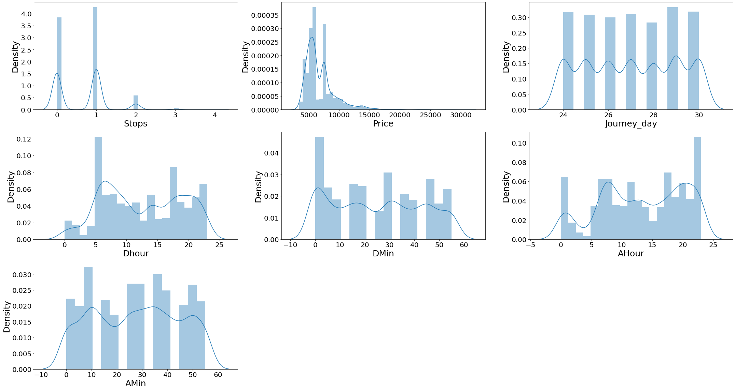
Univariate Visualization of numerical columns

Slide 13
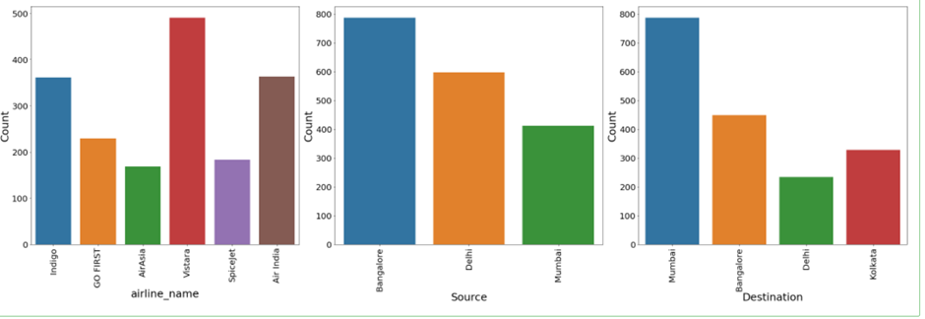
Univariate Visualization of Categorical columns

Slide 14
UNIVARIATE ANALYSIS
Observations:
Vistara has maximum count which means most of the passengers preferred Vistara for there travelling.
Bangalore has maximum count for source which means maximum passengers are choosing Bangalore as there source.
Mumbai has maximum count for Destination which means maximum passengers are choosing Mumbai as there Destination.

Slide 15
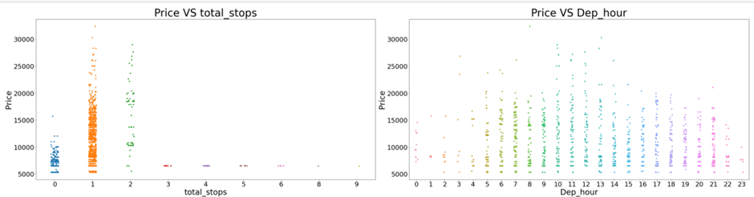
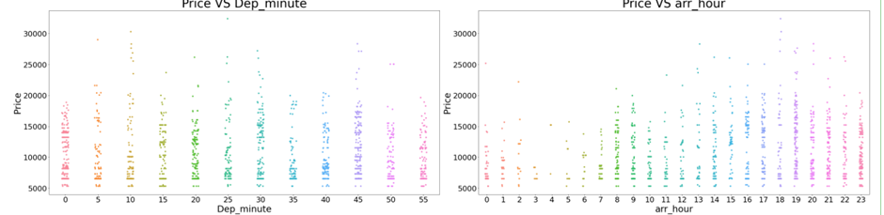
BIVARIATE ANALYSIS
Strip plot for numerical columns

Slide 16
BIVARIATE ANALYSIS
Observations:
1. Flights with 1 stop costs more price compared to other flights.
2. At noon time of every day the flight Prices are high so it looks good to book flights rather than noon.
3. And Departure minute has less relation with target Price.
4. At 7AM to 1PM Arrival time of every day the flight Prices are high so it looks good to book flights rather than this arrival time.
5. And Arrival minute has less relation with target Price.

Slide 17
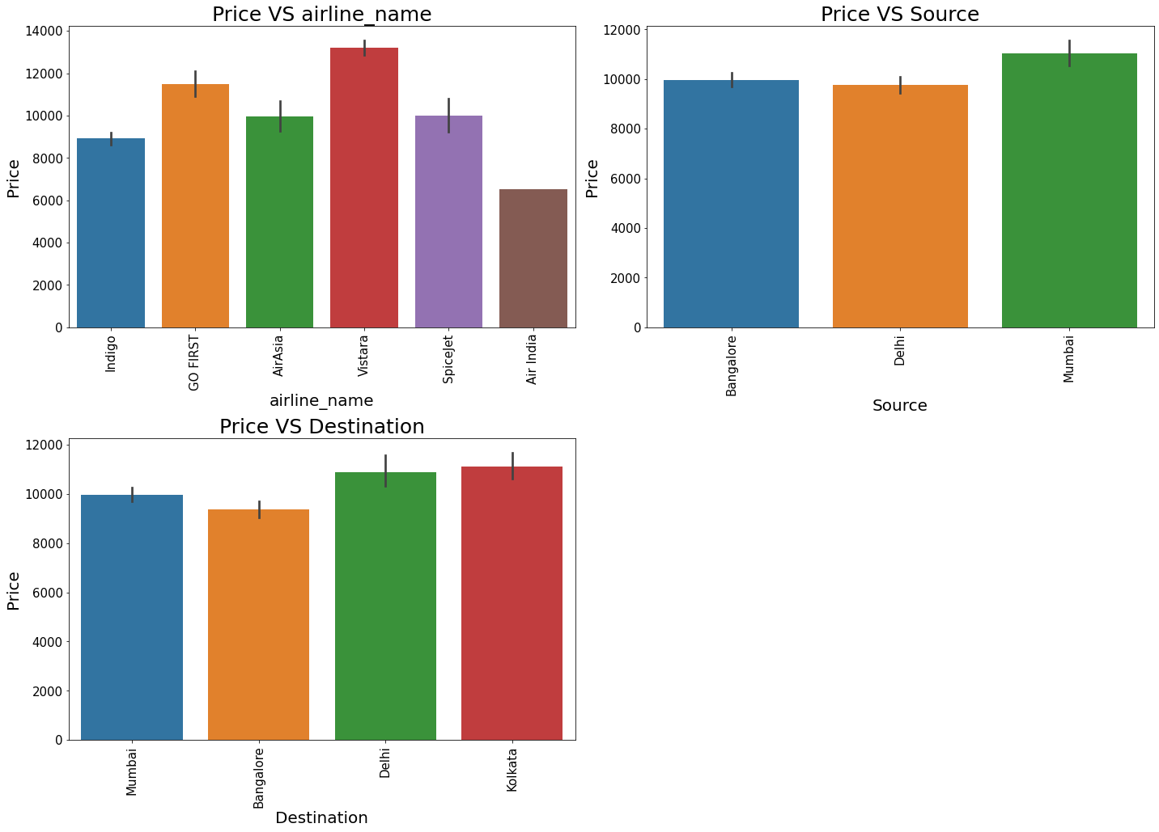
BIVARIATE ANALYSIS
Bar Plot for categorical columns

Slide 18
BIVARIATE ANALYSIS
Observations:
For Go First Airlines the Price is high compared to other Airlines.
All the Sources has approximately same prices.
Destination also has the approximately same prices.

Slide 19
Data Sources and their formats
The dataset is in the form of CSV (Comma Separated Value)
Airline Name - This shows the names of the airlines.
Date of Journey - Gives us the information about the journey date.
Source – Gives us the information about from where the flight will start( location).
Destination – Gives us the information about where the flight will land.
Stops – Shows the number of stops.
Duration – Shows how much time the flight takes to reach the destination.
Departure time – Shows the time when the flight will take off from the source location.
Arrival Time – Shows the time when the flight will reach the destination.
Price - Lists the price of the flights.
We can see our dataset includes a target label "Price" column and the remaining feature columns can be used to determine or help in predicting the price of the flights.

Slide 20
Data Pre-processing Done
Importing the necessary dependencies and libraries.
Reading the CSV file and converted into data frame.
Checking the data dimensions for the original dataset.
Looking for null values and accordingly fill the missing data.
Checking the summary of the dataset.
Checking unique values.
Checking all the categorical columns in the dataset
Checking for multi collinearity using VIF.
Performed Feature Importance using ExtraTrees Regression

Slide 21
Data Inputs- Logic- Output Relationships
The input data were all object type , so had to clean the data by initializing the prize column and converting the same into float type and ensuring all the categorical features are converted to numeric form with the help of LabelEncoder Method. Since most of the features were of categorical type, we did not have to worry much about skewness and outliers

Slide 22
Interpretation
From the above EDA we can easily understand the relationship between features and can also determine which features are affecting the price of the flights.
In UNIVARIATE Analysis, I have used count plots to visualize the counts in categorical variables and distribution plots to visualize the numerical variables.
In BIVARIATE Analysis, I have used bar plots, to check the relation between label and the features.
Used pair plots to check the pairwise relation between the features.
The heat map and bar plot helped in understanding the correlation between dependent and independent variables.
Detected outliers and skewness with the help of box plots and distribution plots respectively.

Slide 23
Conclusion:
In this project report, we have used machine learning algorithms to predict the flight price. We have mentioned the step by step procedure to analyze the dataset and finding the correlation between the features.
Thus we can select the features which are correlated to each other and are independent in nature. The power of visualization has helped us in understanding the data by graphical representation it has made me to understand what data is trying to say.
Data cleaning is one of the most important steps to remove unrealistic values and unnecessary values.
These feature set were then given as an input to seven algorithms and a hyper parameter tunning was done to the best model and the accuracy has been improved. Hence we calculated the performance of each model using different performance metrics and compared them based on these metrics.
Then we have also saved the best model and predicted the flight price. It was good that the predicted and actual values were almost same.
To conclude, the application of machine learning in flight price prediction is still at an early stage. We hope this study has moved a small step ahead in providing some methodological and empirical contributions to online platforms, and presenting an alternative approach to the valuation of flight price.
Future direction of research may consider incorporating additional flight data from a larger economical background with more features.

